Slide 1
BLOB: Your Personal Finance Helper
By: Lina Sprague
October 2018

Slide 2
Topics For Discussion
Purpose of BLOB
Features
Cost of living
My Blob
Resources
Future enhancements
Demo of BLOB

Slide 3
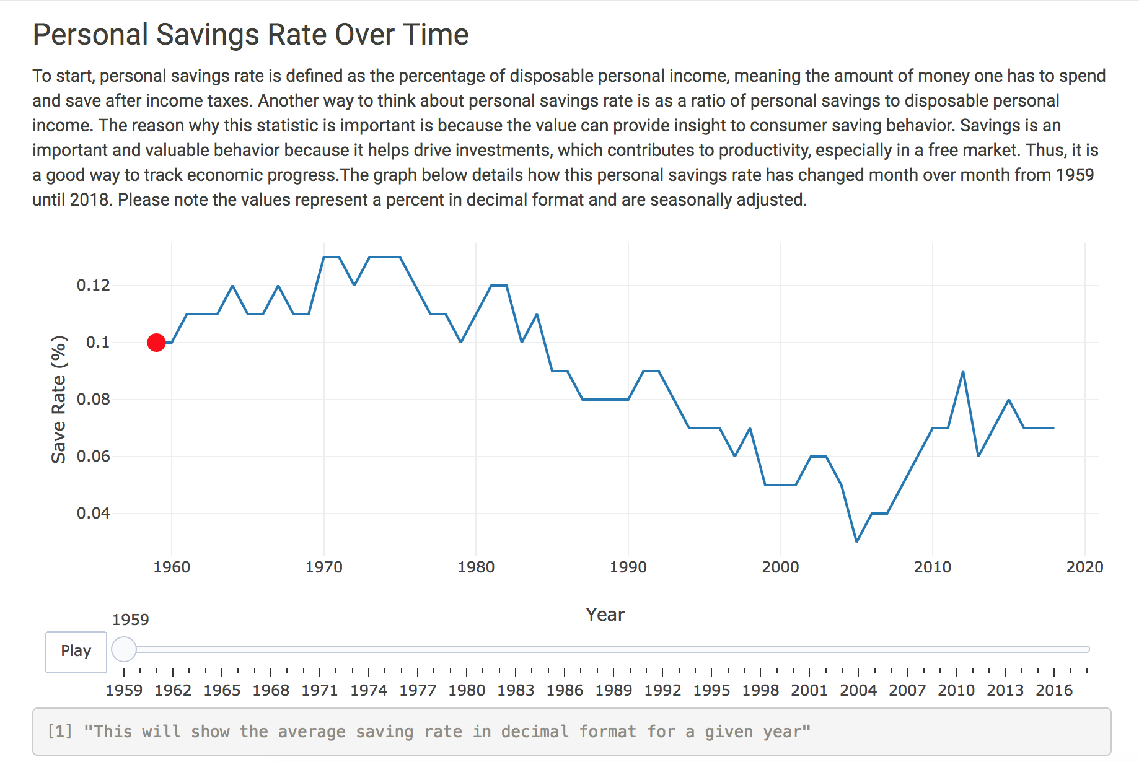
Who is BLOB?
My stuffed animal from Japan!
“Money helper”
Perception of money
Saving behavior
Planner
Organizer
Resource

Slide 4
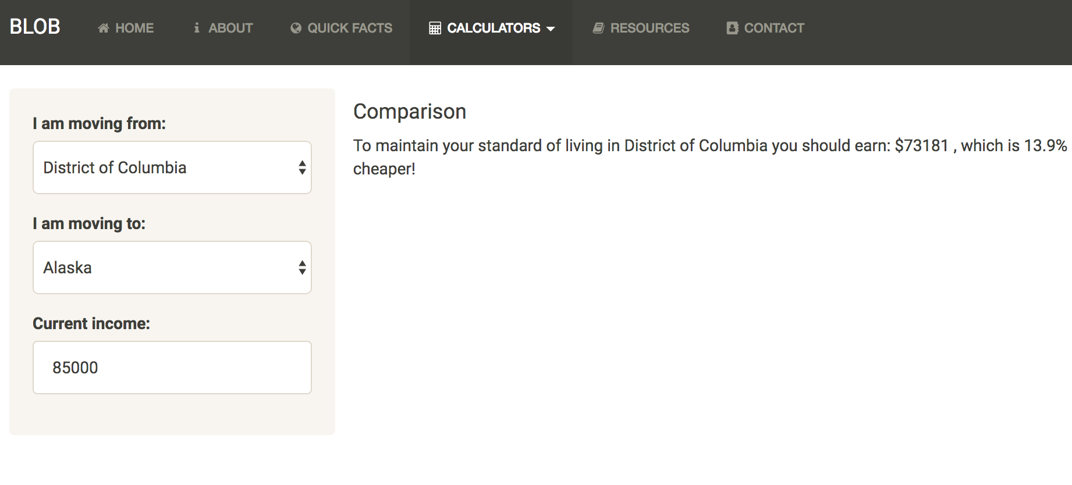
Features – Cost of Living Calculator

Slide 5
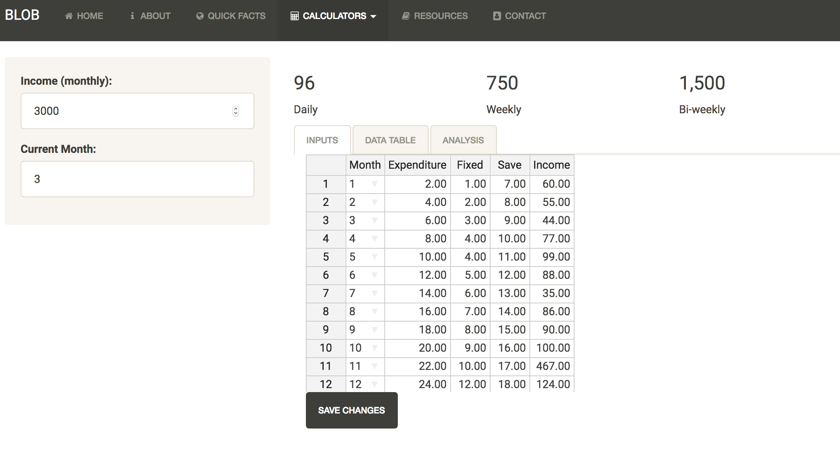
Features – My BLOB

Slide 6
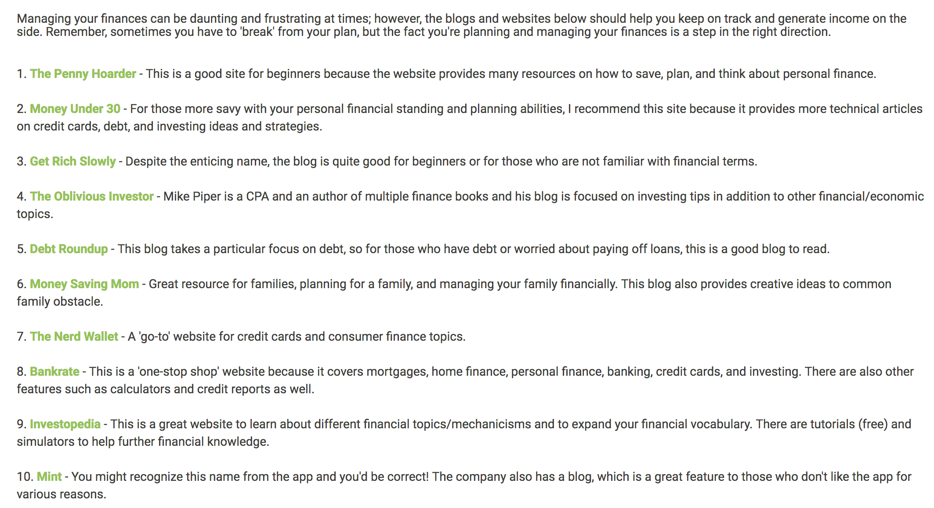
Features – Resources

Slide 7
Future Enhancements
Link to bank account securely
Link to other budgeting / expense apps to make inputting expense inputs a faster process
Make available to mobile apps for both Apple and Android
Partner with investment apps or companies

Slide 8
Demo time!
https://csprague12.shinyapps.io/BLOB/

